Slide 1
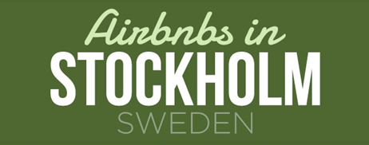
For lower-middle-class solo travelers, which is the best location in Stockholm, Sweden to stay?
Trần Hà Tú Khuê

Slide 2
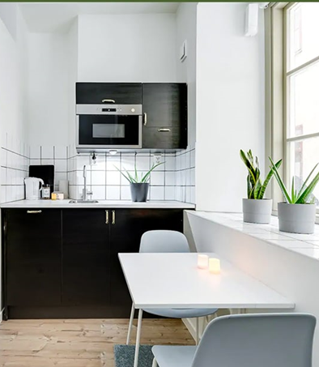
Agenda
Introduction
Exploratory Data Analysis
Recommendations

Slide 3
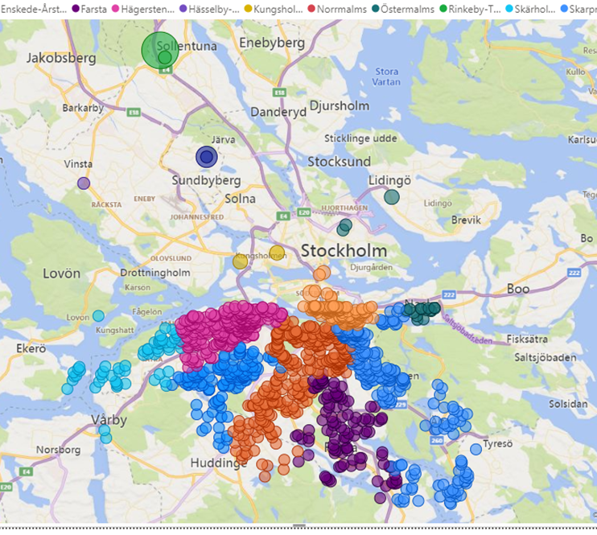
Introduction
Air BnB market trends in Sweden
2022 has been the year that the tourism and travel industries rebound
Most businesses are back to normal → more people taking business-related trips → the Airbnb business will see increased bookings and better returns
According to Air BnB: Sweden’s progressive values made it an attractive partner

Slide 4
Introduction
Focus groups:
Lower middle-class solo tourists looking for an affordable stay for their holiday in Stockholm
Research questions…
Location:
Which neighborhood has the cheapest accommodates?
Room type:
Which room type has the cheapest accommodates?

Slide 5
2. Exploratory Data Analysis
For lower-middle-class solo travelers, which is the best location in Stockholm, Sweden to stay?
Location
Capacity
Price
Rating score
Availability

Slide 6
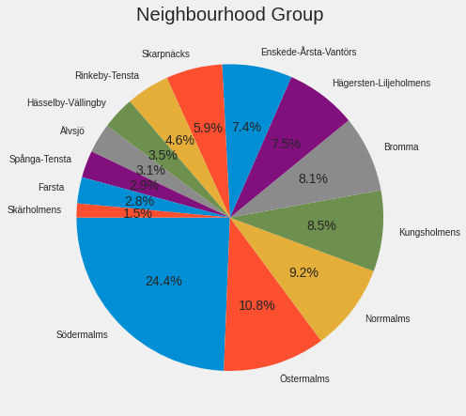
2. Exploratory Data Analysis
Location
Airbnb Listings in Stockholm near Södermalms, Östermalms, Norrmalms, Kungsholmens have the highest share of accommodates.
Södemalms has the most accommodates nearest to Stockholm city center
One host has the most listings in Sollentuna, but is the farest to the center
Rinkeby-Tensta has the least number of listings

Slide 7
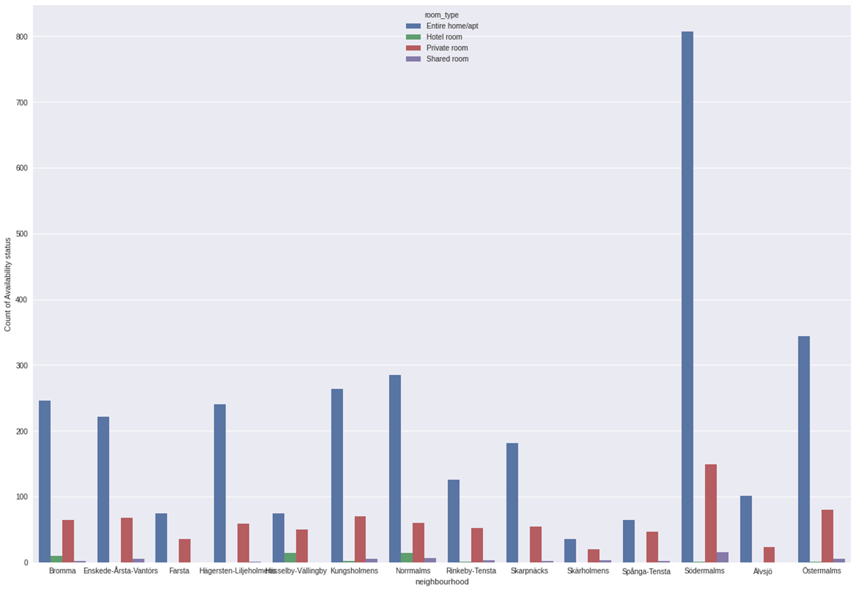
2. Exploratory Data Analysis
Södemalms, Östermalms have the most air bnbs listings
Entire home is listed most near Södermalms, while Entire home and Private room near Hasselby-Vallingby and Spanga-Tensta are nearly equal
Södemalms, Östermalms, Bromma, Normalms could be more suitable for solo or couple travelers
Houses in Södemalms are suitable for small-sized families as this location has the highest number of entire homes
Hassellby-Vallingby is an appropriate option for those seeking hotel rooms
b) Capacity
Total listings by Location & Room type

Slide 8
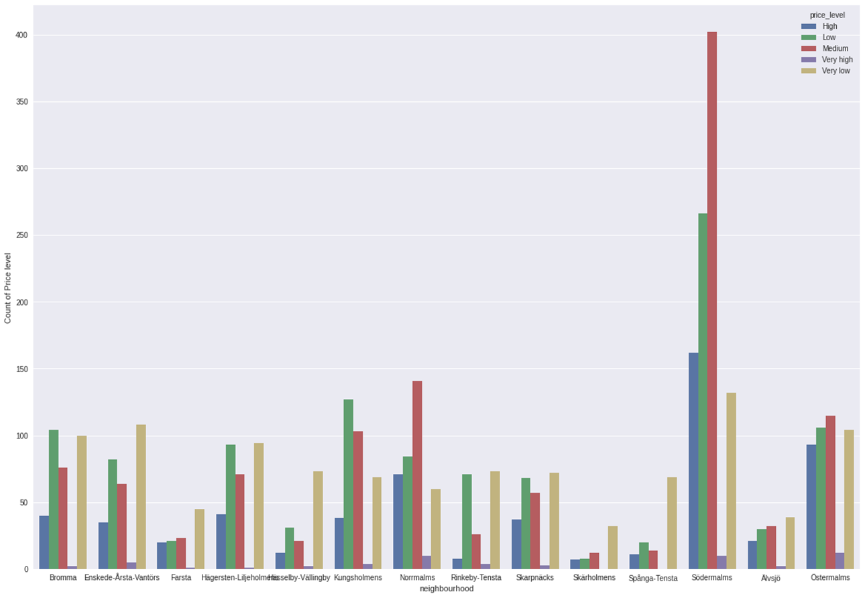
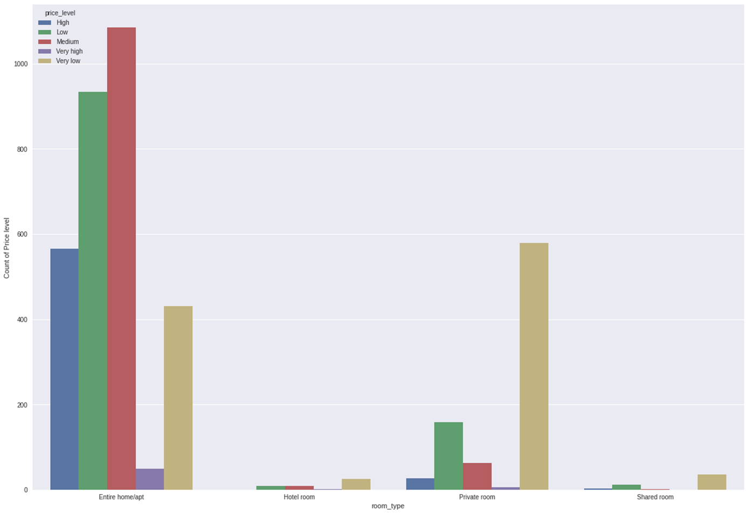
2. Exploratory Data Analysis
By neighbourhood:
Södermalms, Östermalms, Kungsholmens, Hägersten-Lijeholmens have the highest number of inexpensive accommodates
On average, Normalms accommodates have the highest price, at 1700 SEK
By room type:
Private room & share room offer the lowest price, at 750 SEK
Entire home & private room have the highest number of cheap accomodates
c) Price
Price by neighborhood
Price by room_type

Slide 9
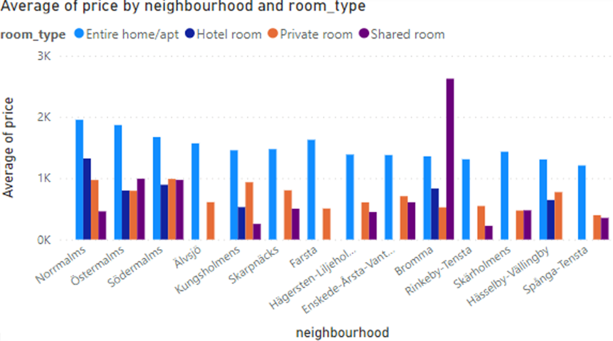
3. Key insights
Södemalms hosts offer the lowest price for tourists, followed by Östermalms, Brömma, Enskede-Arsta-Vantor
Low-budget solos are recommended to choose shared rooms/ private rooms in Rinkeby-Tensta or Kungsholmen
c) Price

Slide 10
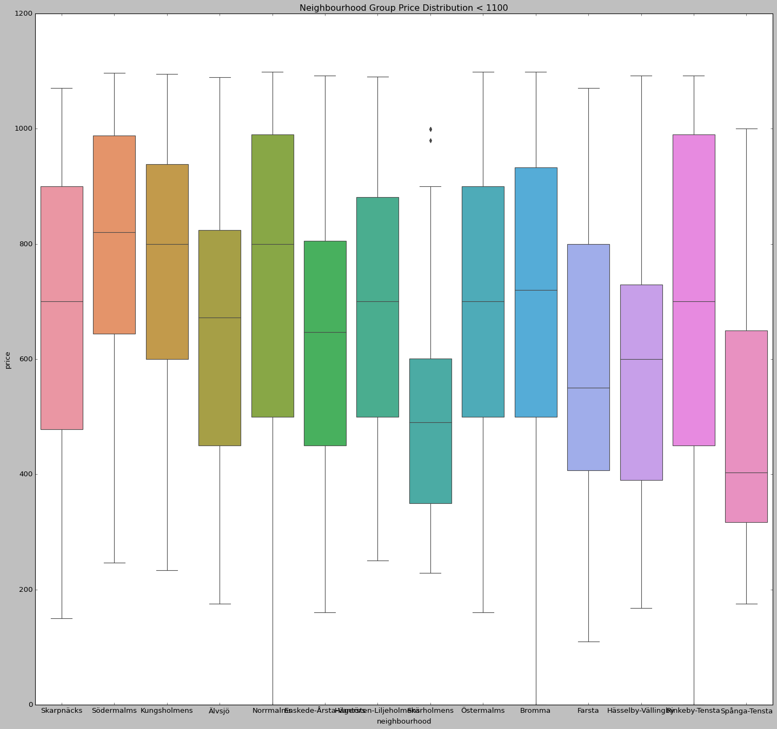
2. Exploratory Data Analysis
These areas seem to have similar distribution
Spanga-Tensta is the cheapest
Average price of Södermalms’ listings is among the lowest, at 700 SEK
c) Price - Price distribution of cheap listings

Slide 11
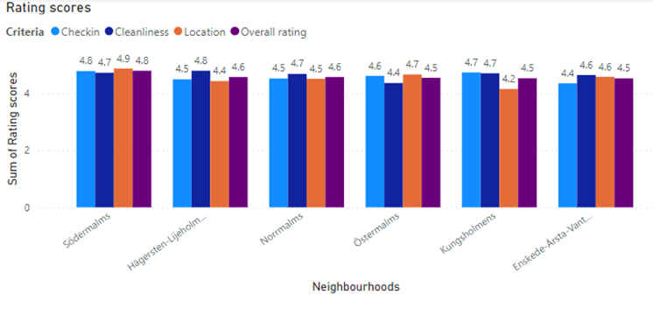
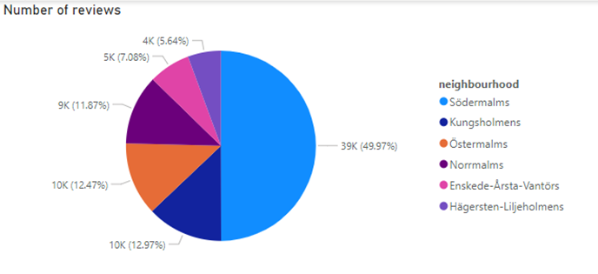
2. Exploratory Data Analysis
Checkin: Södermalms > Kungsholmens > Östermalms > Norrmalms & Hägersten-Lijeholmens > Enskede-Årsta-Vantörs
Cleanliness: Hägersten-Lijeholmens > Södermalms, Norrmalms, Kunsholmens > Enskede-Årsta-Vantörs > Östermalms
Location: Södermalms > Östermalms > Enskede-Årsta-Vantörs > Norrmalms > Hägersten-Lijeholmens > Kungsholmens
Overall score: Södermalms > Hägersten-Lijeholmens & Norrmalms > Östermalms, Kunsholmens, Enskede-Årsta-Vantörs
→ Södermalms & Hägersten-Lijeholmens are ideal locations
d) Rating score of top 6 cheapest areas

Slide 12
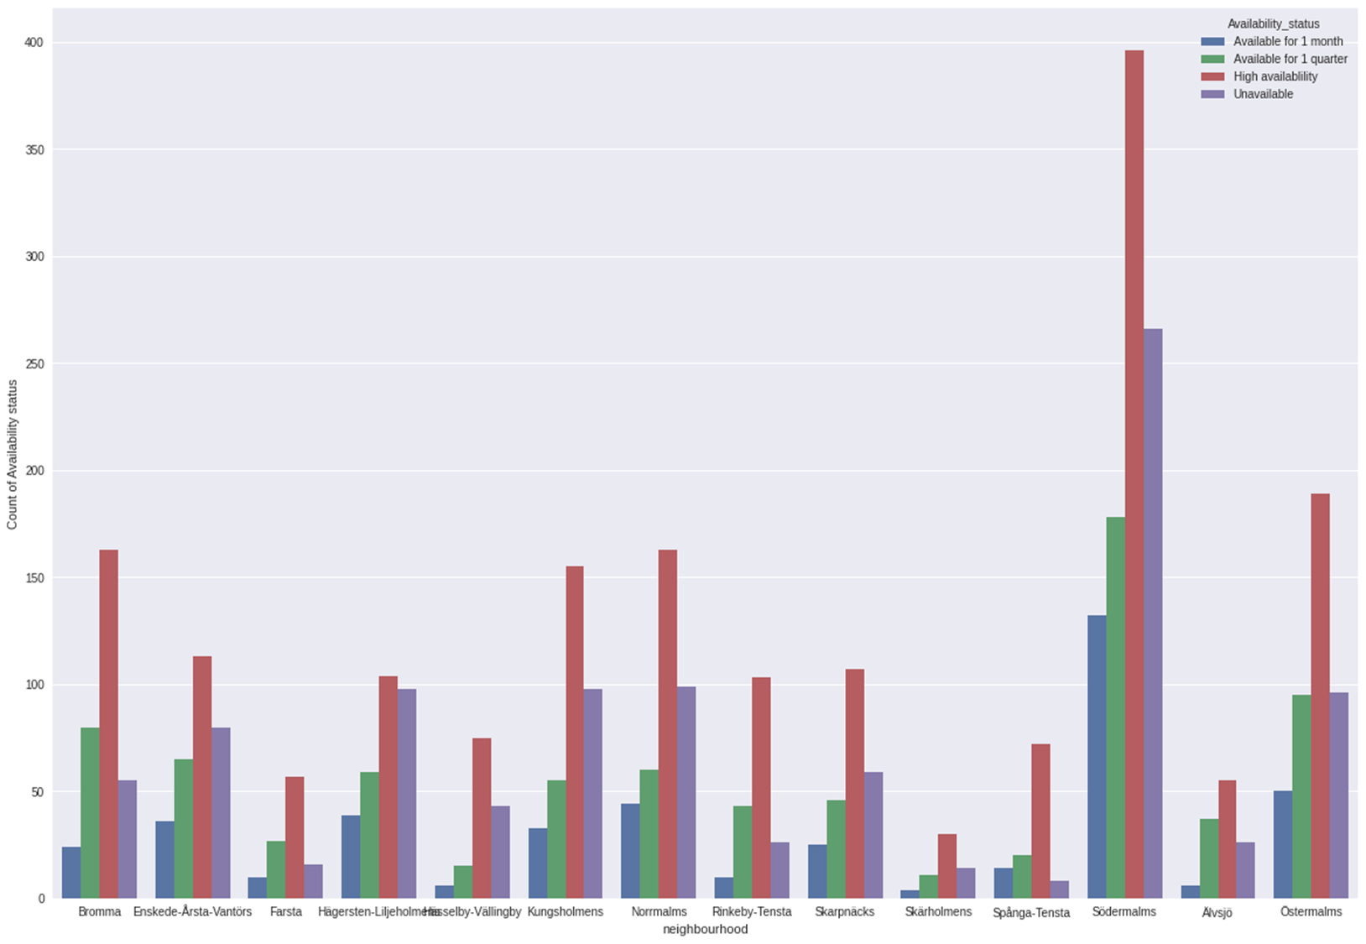
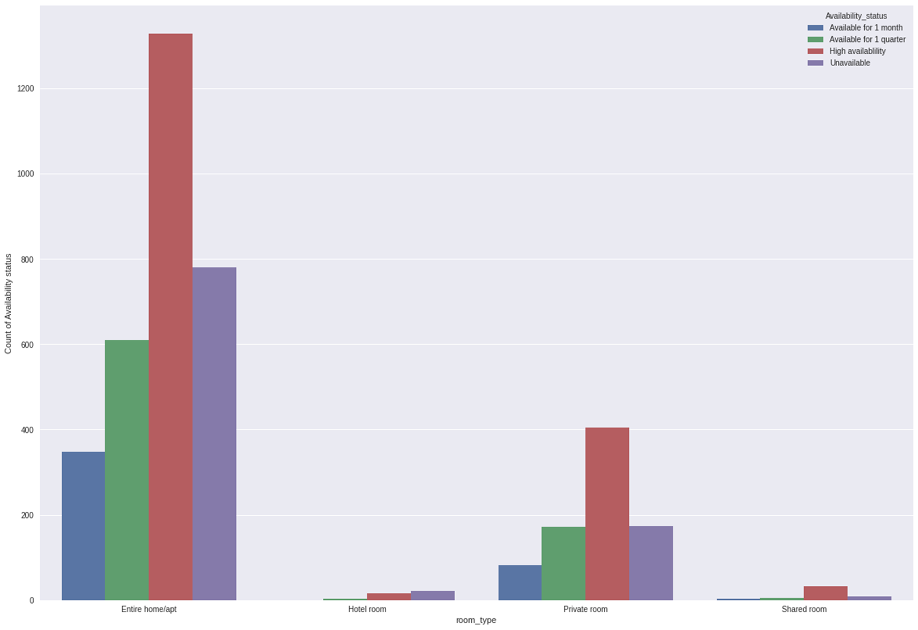
2. Exploratory Data Analysis
Many air bnbs in Södemalms are available
Unavailable accomodates/ Total listings ratio:
Hagersten-Liljeholm: unavailable accomodates are ¼ of total listings
Rinkeby-Tensta: has the lowest ratio
Room type: Entire home has the most available air bnbs, whereas shared room has the least
e) Availability
Number of Air BnBs based on availability status by Neighbourhood
Number of Air BnBs based on availability status by Room type

Slide 13
3. Recommendations
Private room in Södemalms would be the best option for low-and-medium-income tourists due to:
Location - closest to Stockholm center
Affordable price
High capacity
High availability
High rating score
Higher privacy compared to Shared Room
Entertainment:
Several parks and breathtaking panoramic views of Stockholm: Fjällgatan and Monteliusvägen
A myriad of vintage stores, eclectic shops, Swedish fashion, galleries and design stores

